Slide 1

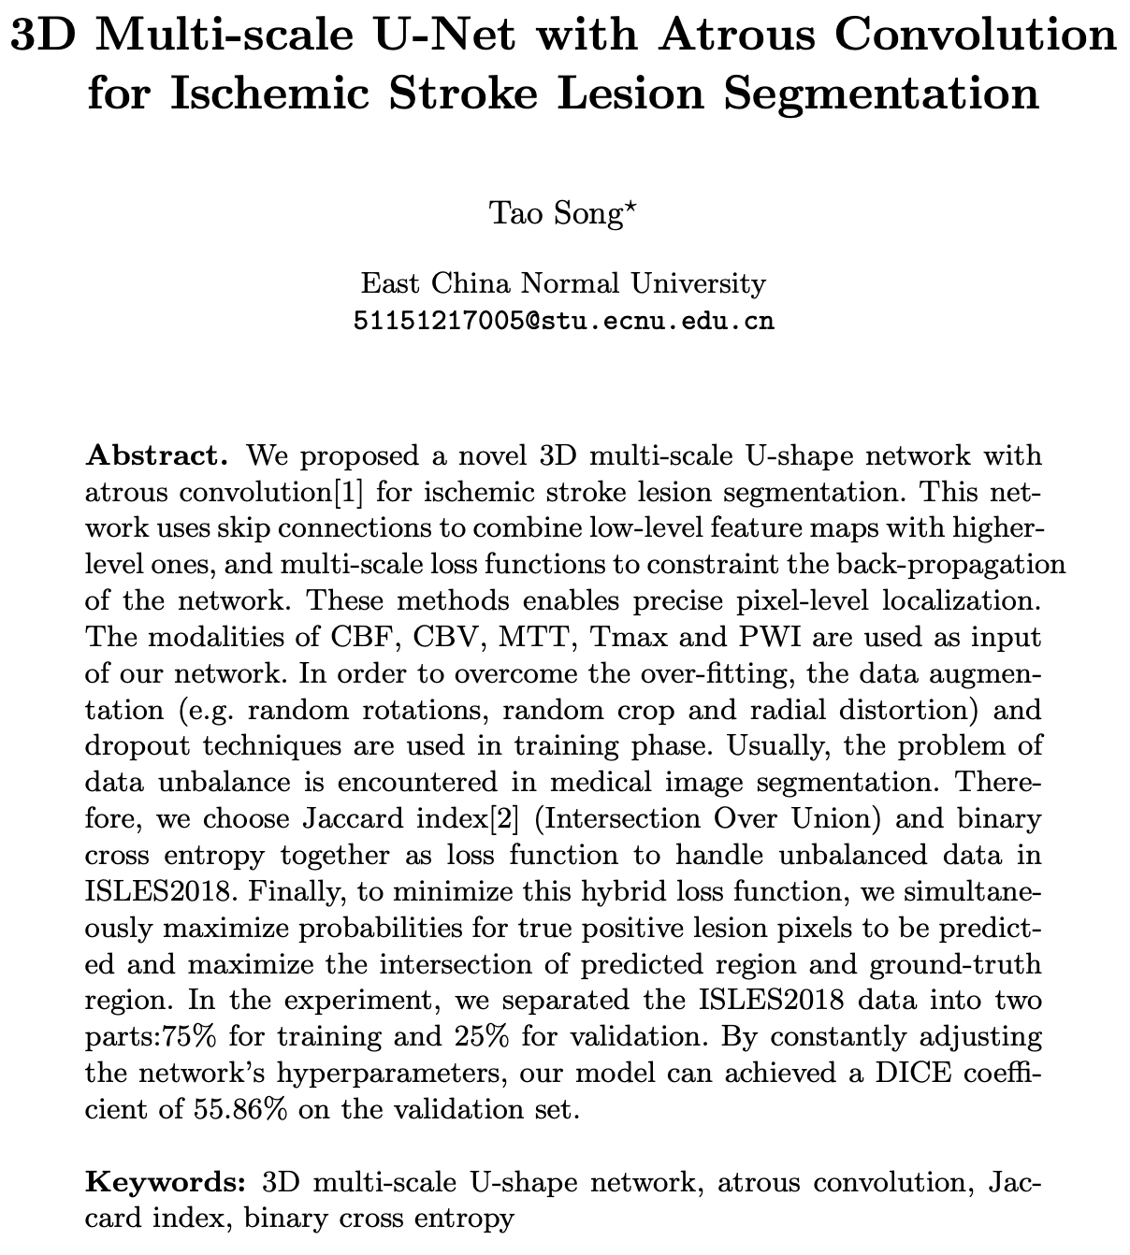
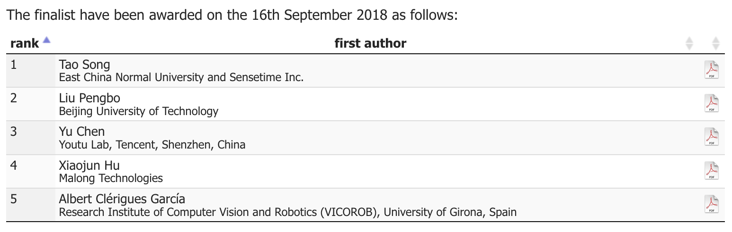
ISLES CHALLENGE 2018 – rank 1 short paper

Slide 2
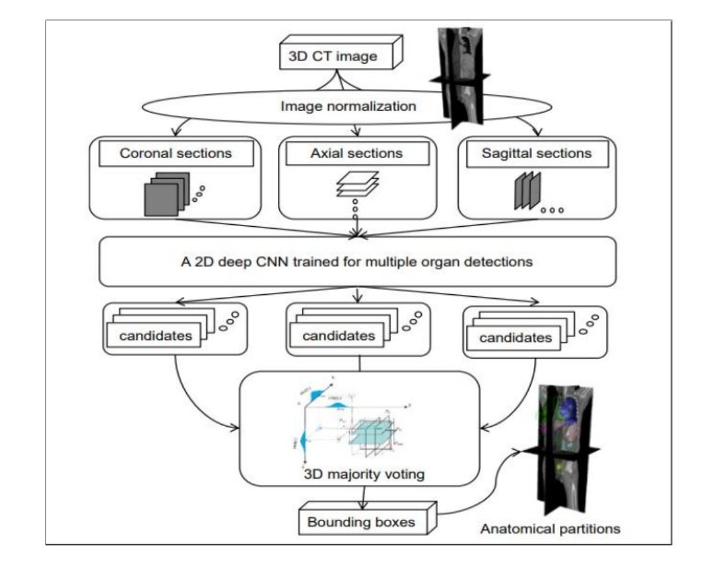
Multi 2d convoluation stack

Slide 3
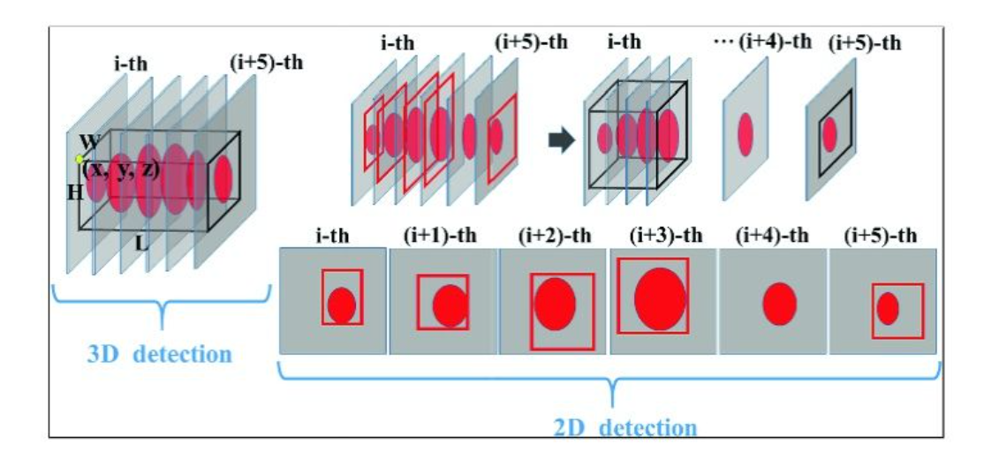
2d convoluation voting mechanism

Slide 4
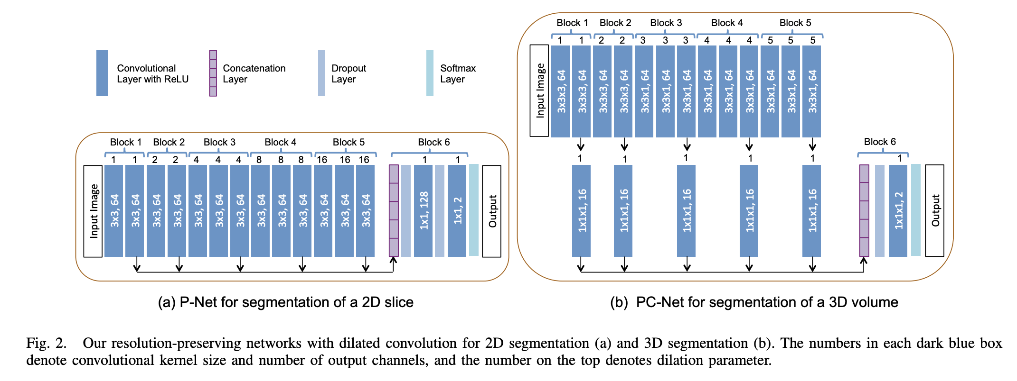
Interactive Medical Image Segmentation using Deep Learning with Image-specific Fine-tuning

Slide 5
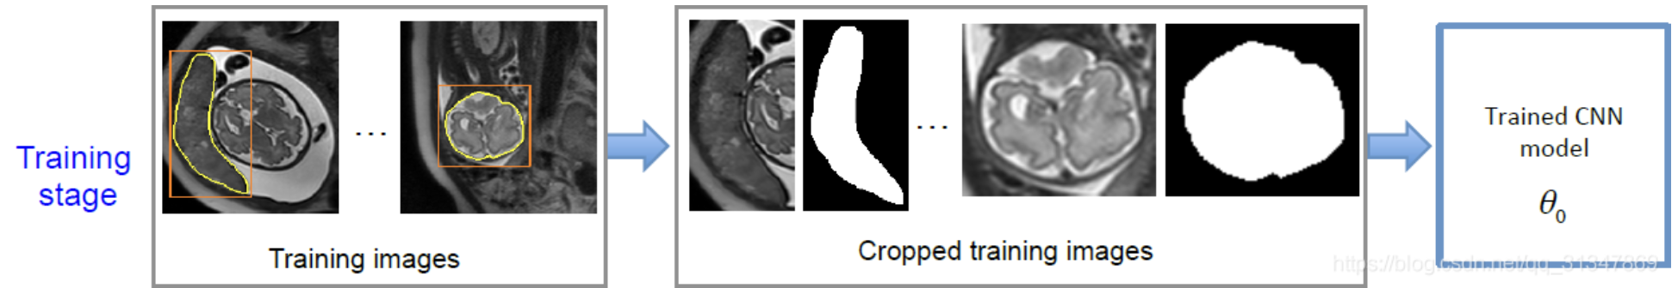
P-Net & PC-Net

Slide 6
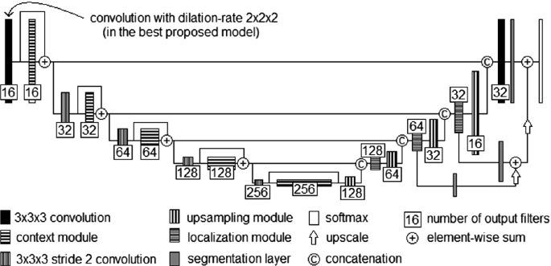
ISLES Challenge: U-Shaped Convolution Neural Network with Dilated Convolution for 3D Stroke Lesion Segmentation

